Slide 1

Happiness Foundation
Made By: Ayush Mundra (B032)
Jagrit Acharya (B001)

Slide 2
OUTLINE
INTRODUCTION (IDEA): Explaining the motivation and scope of the project
LAYOUTS (UI DESIGN)/VISUALIZATION : Screen shots of the UI / Visualization graphs depending on project
LINKING AND IMPLEMENATION WITH DEMO
CONCLUSION

Slide 3
Problem Statement
We see in our daily life that we have goods that can be reused by other people for example (previous classes or semester books, old clothes of our family members etc.), as we don't have any right place where we can share it with some needy people who could get benefits of those things Instead of just throwing the stuff in the garbage or selling them to other shopkeepers, it is the underutilization of the product which can be used in a better way, like sharing with others.
NGO is not reachable, and we don’t have any idea what they need.

Slide 4
Introduction
This is a website where donator can donate their things to other users and NGOs which are not useful for him/her anymore.
We are allowing users to donate their belonging easily as they see the list of all the NGOs and other users who has posted request for help.
We have also solved the problem for the NGO as they can also see the products (items which are offered by donator) so they can specifically contact the donors and get that product which they need.

Slide 5
Project Structure

Slide 6
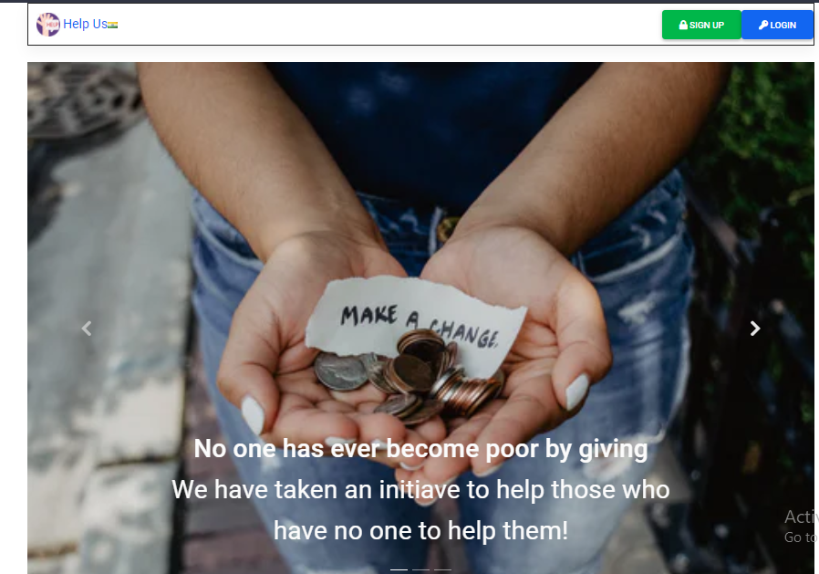
Home page
(“http://127.0.0.1:8000/donator/home”)

Slide 7
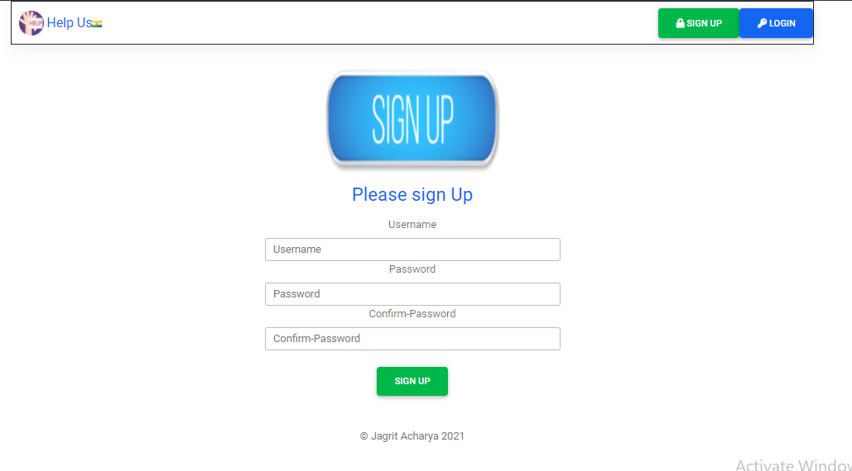
Sign Up Page
(“http://127.0.0.1:8000/accounts/signup”)

Slide 8
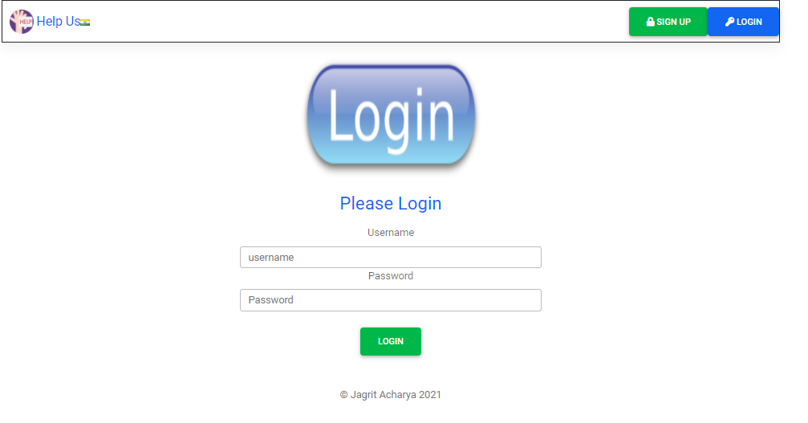
Login Page
(“http://127.0.0.1:8000/accounts/login”)

Slide 9
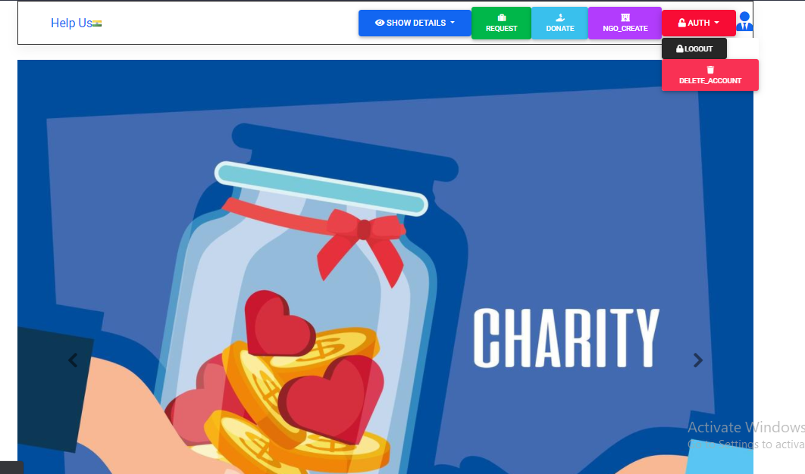
After login Home Page
("http://127.0.0.1:8000/donator/home")

Slide 10
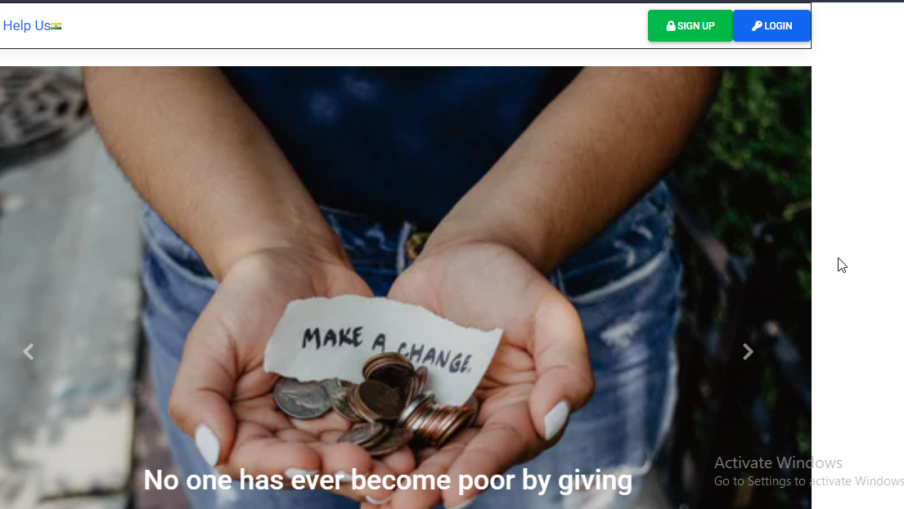
After Logout
(“http://127.0.0.1:8000/accounts/logout”)

Slide 11
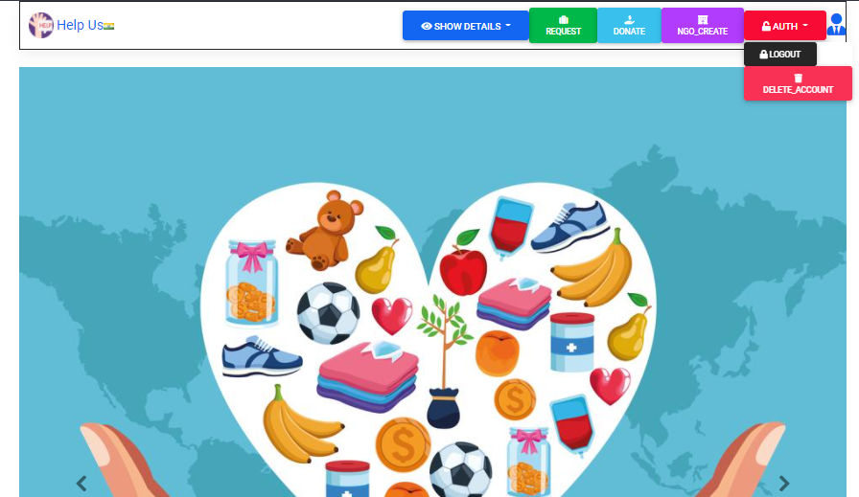
(“HTTP://127.0.0.1:8000/DONATOR/DELETE")
To delete your account from our database

Slide 12
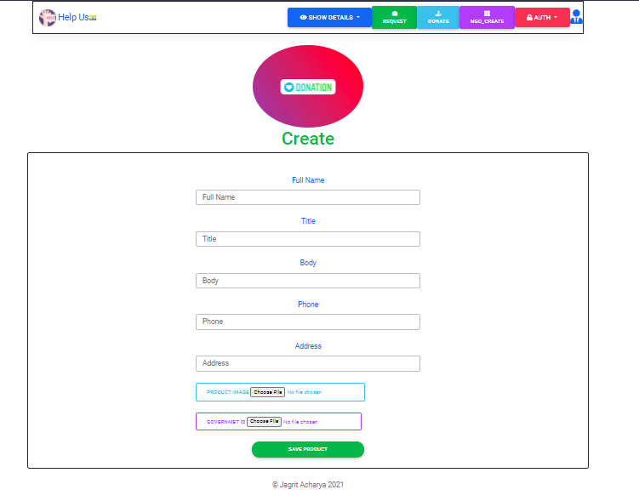
Form for donating item
url(“http://127.0.0.1:8000/donator/create”)

Slide 13
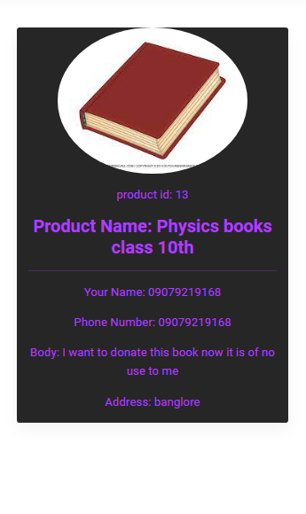
Showing the details of the donation item just created
(“http://127.0.0.1:8000/donator/13”)

Slide 14
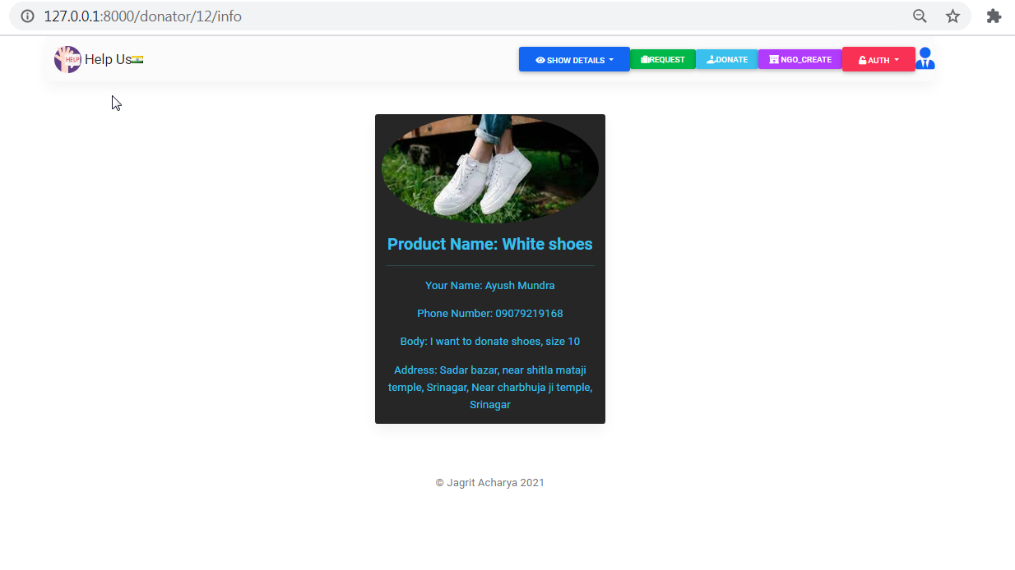
This is used to show the info of any donation item
(“http://127.0.0.1:8000/donator/12/info”)

Slide 15
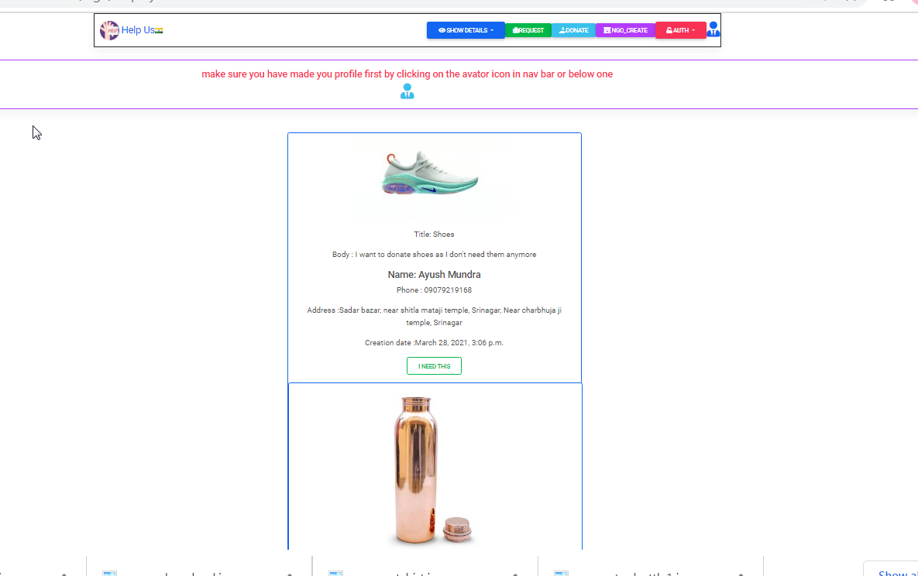
"Show All_items" will show you all the donation items ("http://127.0.0.1:8000/ngo/displayitem")

Slide 16
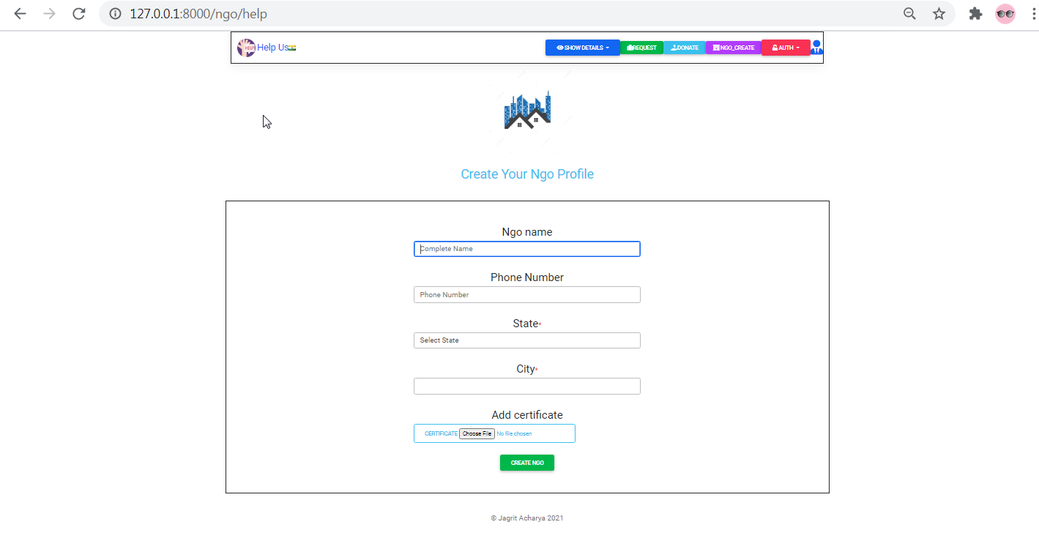
To create a new NGO(press Ngo_create)
(“http://127.0.0.1:8000/ngo/help”)

Slide 17
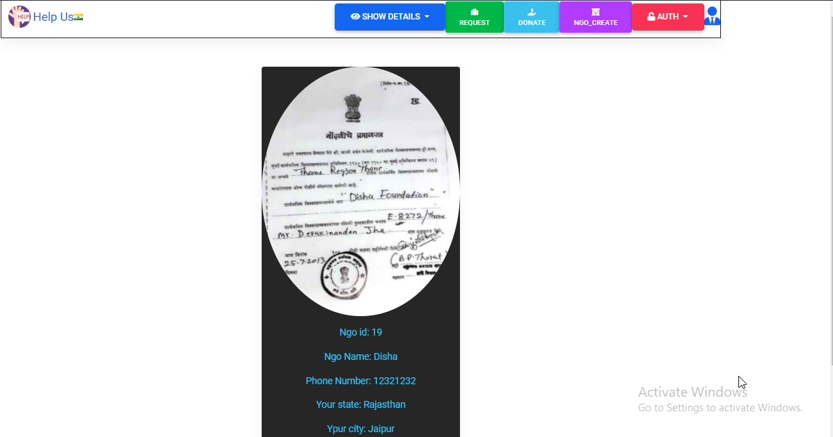
Just after creating the NGO this is the preview
http://127.0.0.1:8000/ngo/19/info2

Slide 18
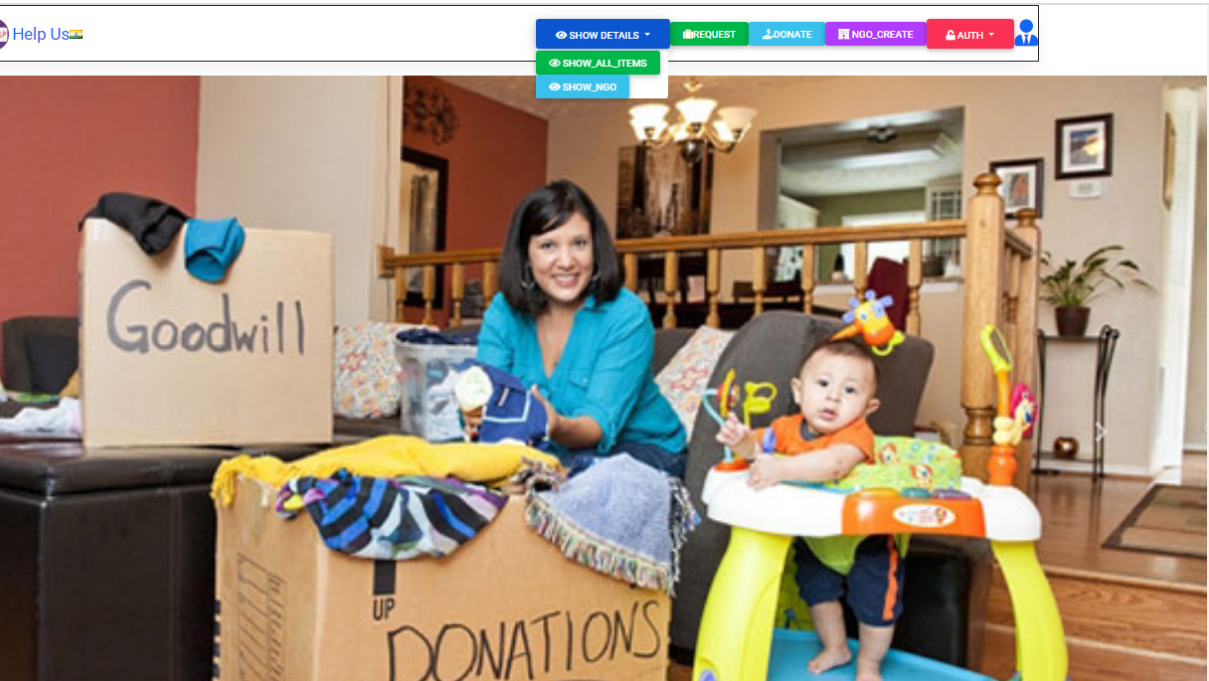
To show all Ngo As per your location
("http://127.0.0.1:8000/ngo/homes")

Slide 19
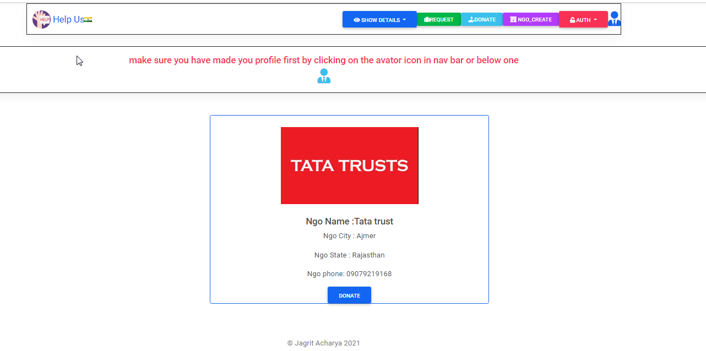
After pressing show ngo button

Slide 20
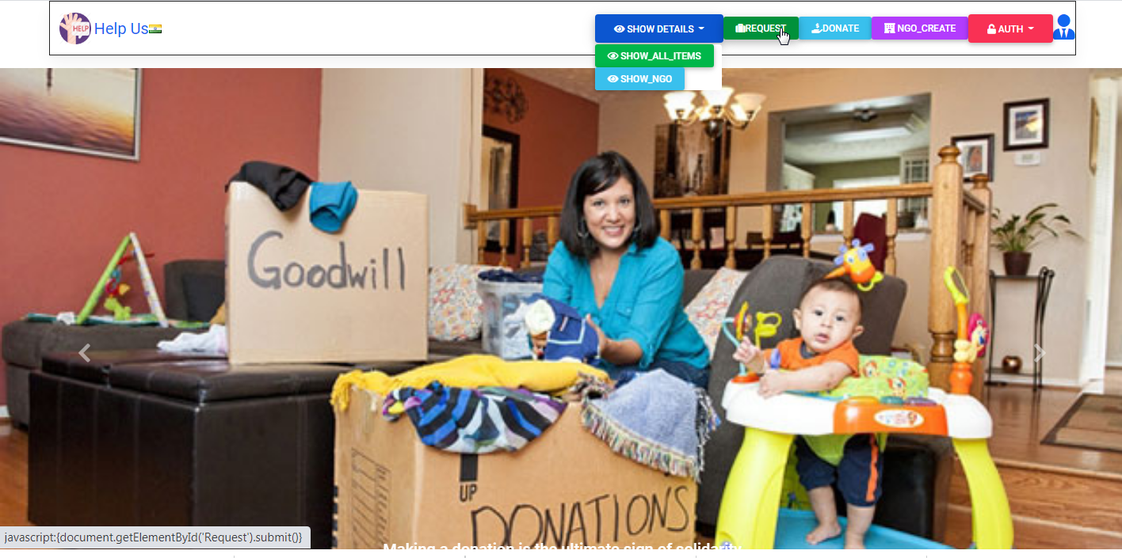
To create request press "Request" button
(“HTTP://127.0.0.1:8000/REQUEST/NEEDREQUEST")

Slide 21
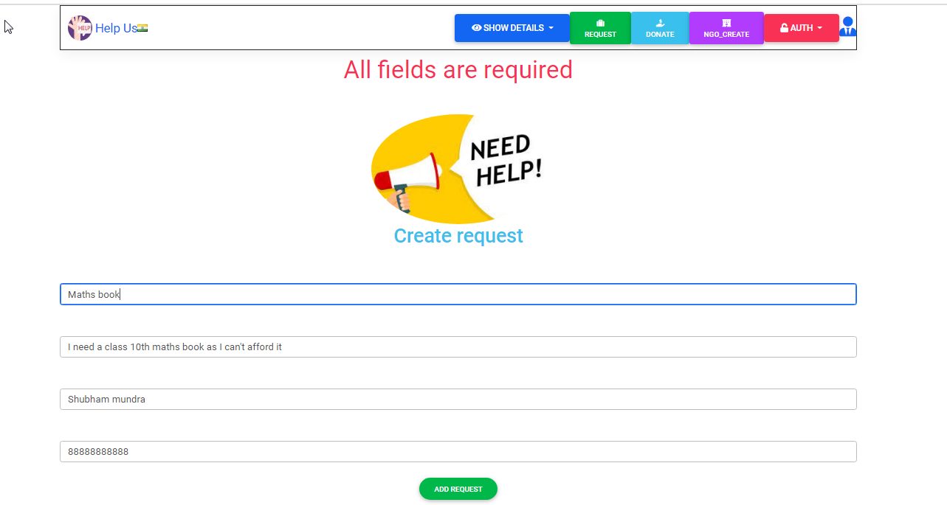
After clicking request

Slide 22
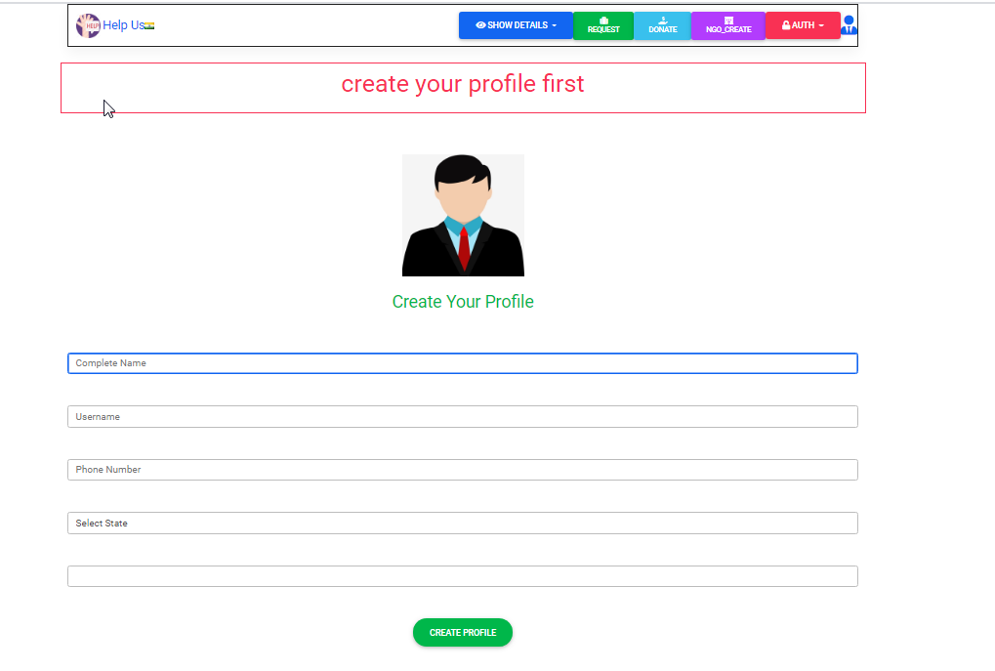
It will ask to create your profile if you haven't created

Slide 23
After making the profile and then filling the form

Slide 24
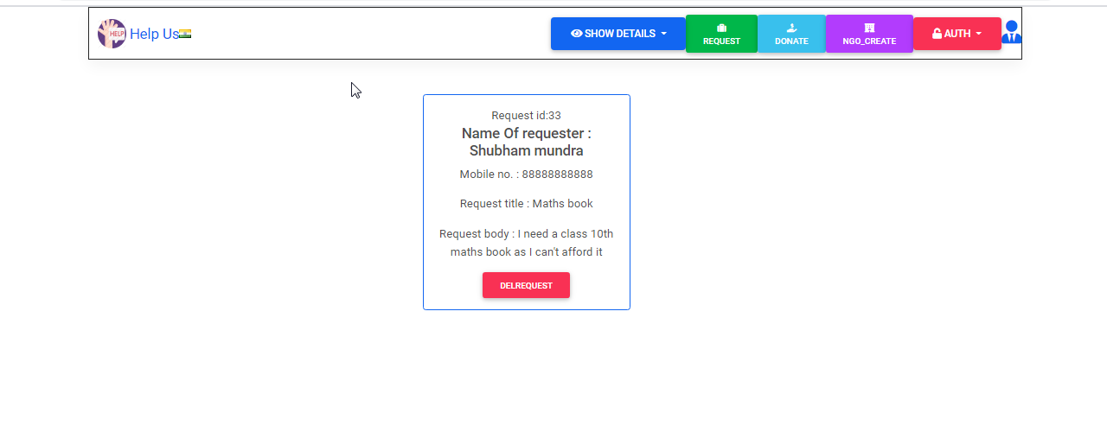
your request created

Slide 25
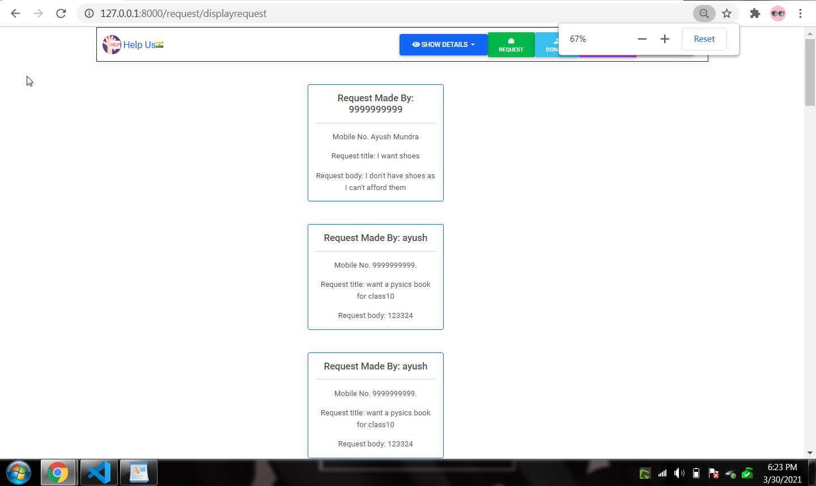
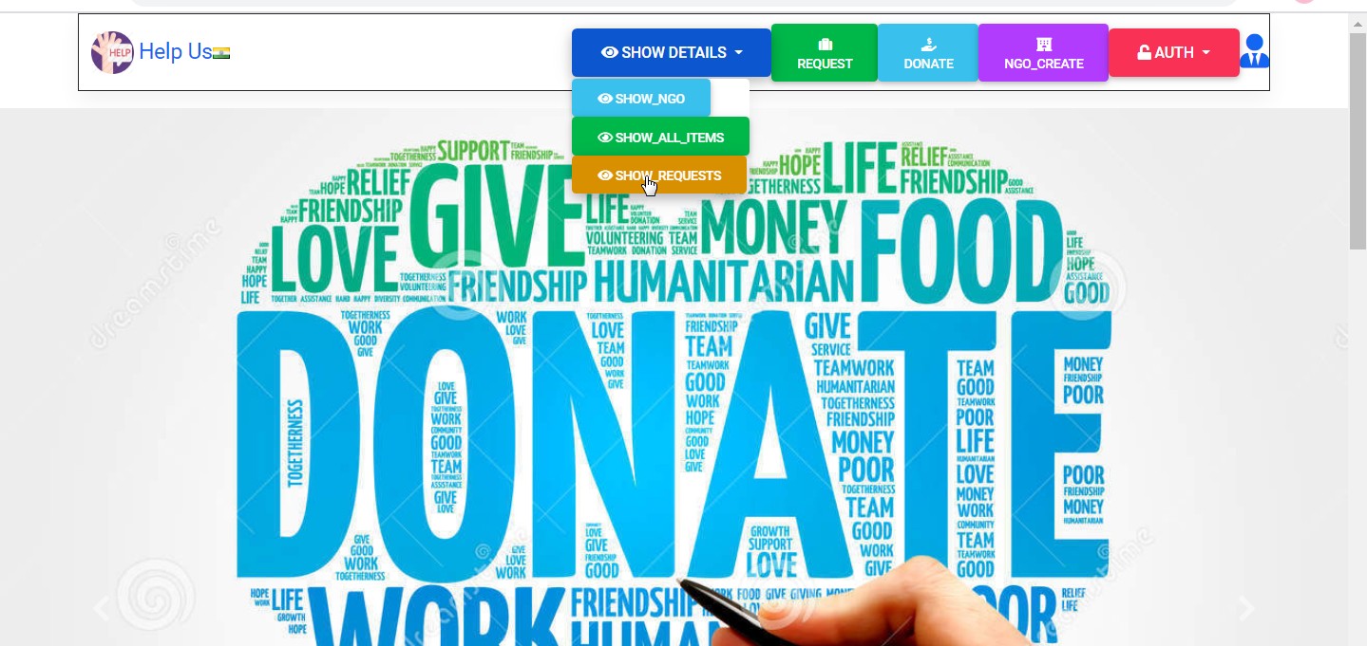
Clicking on display request will show you all the requests
(“http://127.0.0.1:8000/request/displayrequest”)

Slide 26
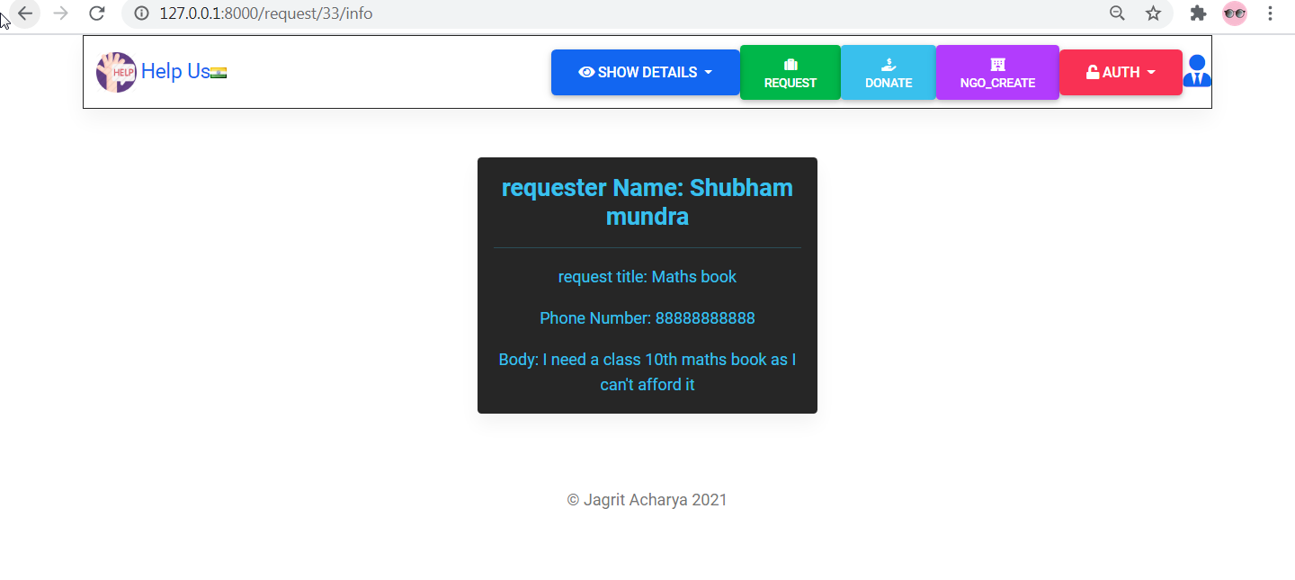
This URL will show you the info of your request.
(“http://127.0.0.1:8000/request/33/info”)

Slide 27
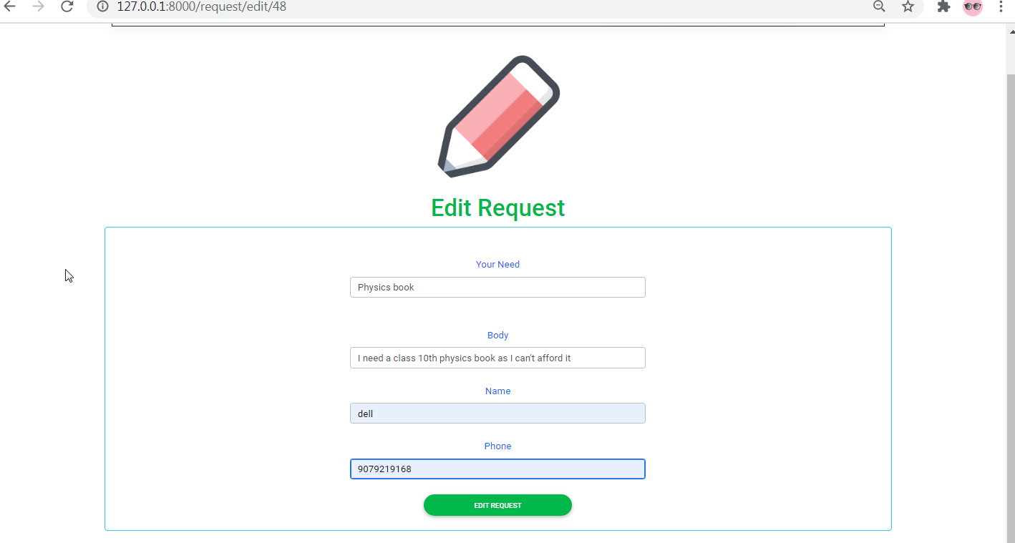
Edit form
(“HTTP://127.0.0.1:8000/REQUEST/edit/48”)​

Slide 28
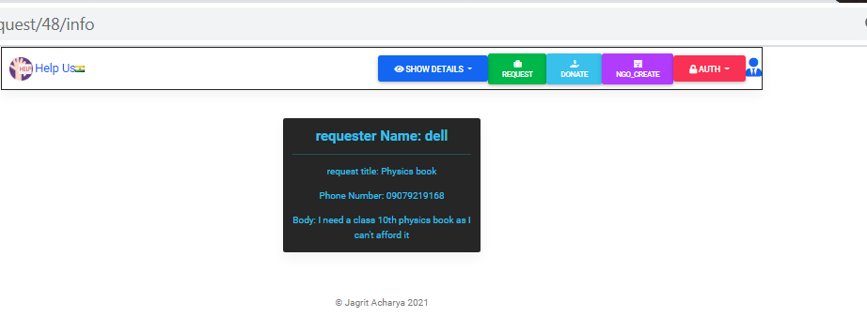
After edit

Slide 29
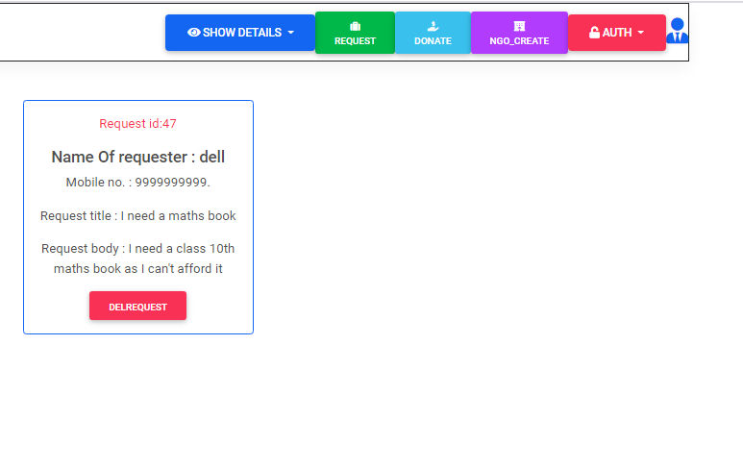
directly delete with delete button after creating

Slide 30
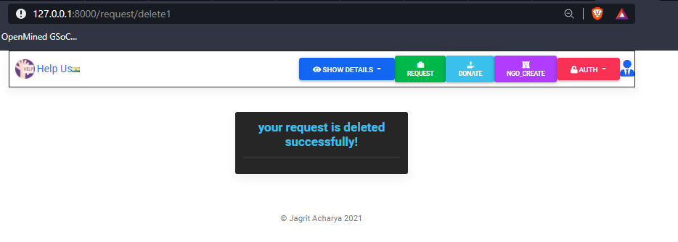
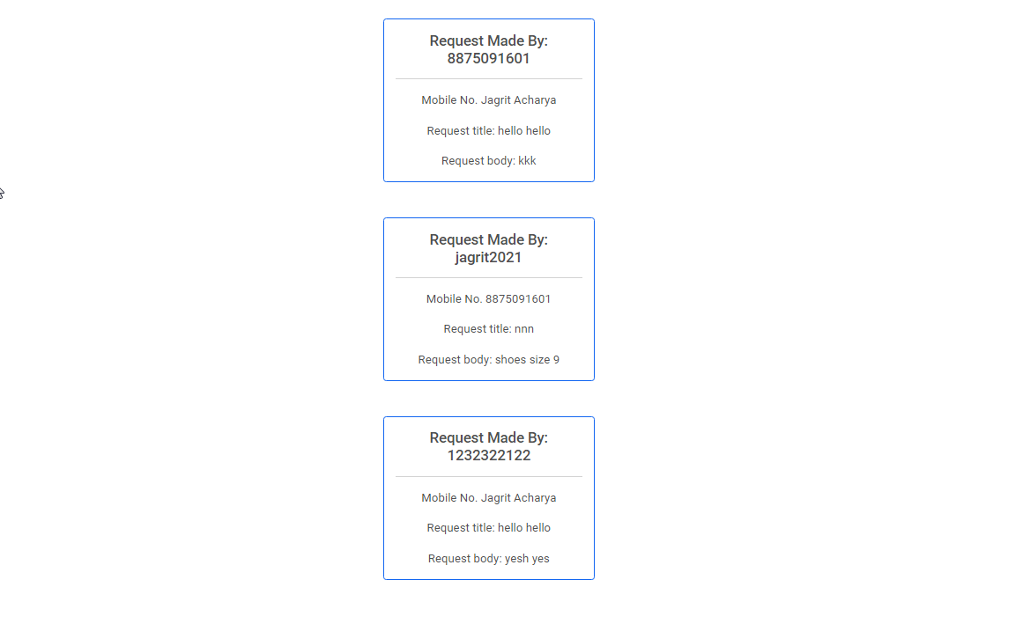
after deleting Your request is no more there
Show Request

Slide 31
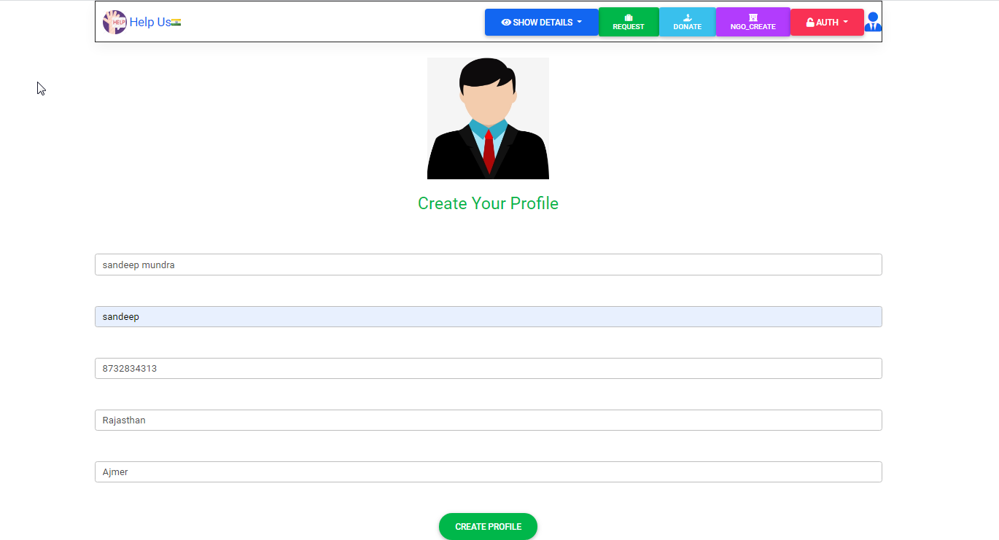
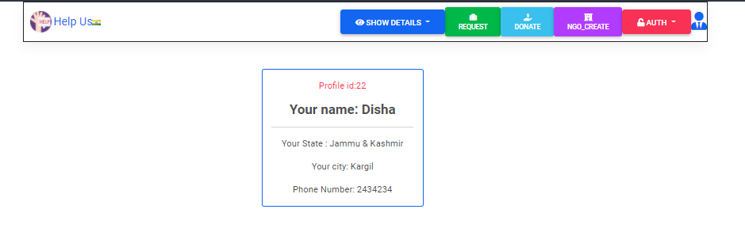
By clicking on Aviator button you can create your profile
(“http://127.0.0.1:8000/profile/createprofile”)

Slide 32
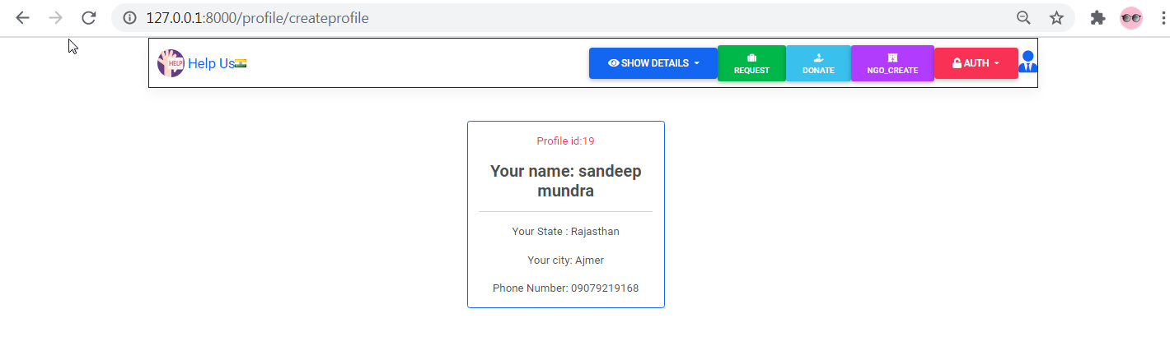
after creating profile

Slide 33
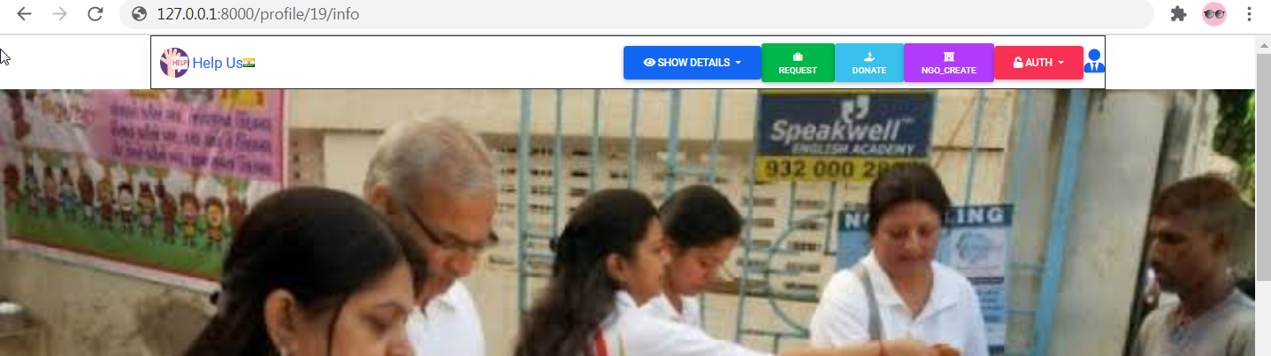
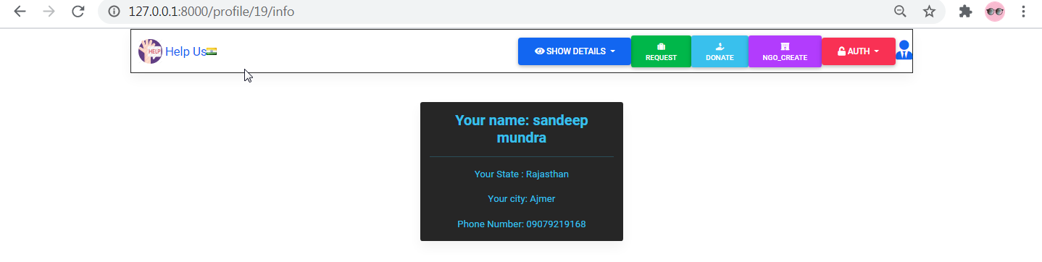
to get the information about your profile
(“http://127.0.0.1:8000/profile/19/info”)

Slide 34
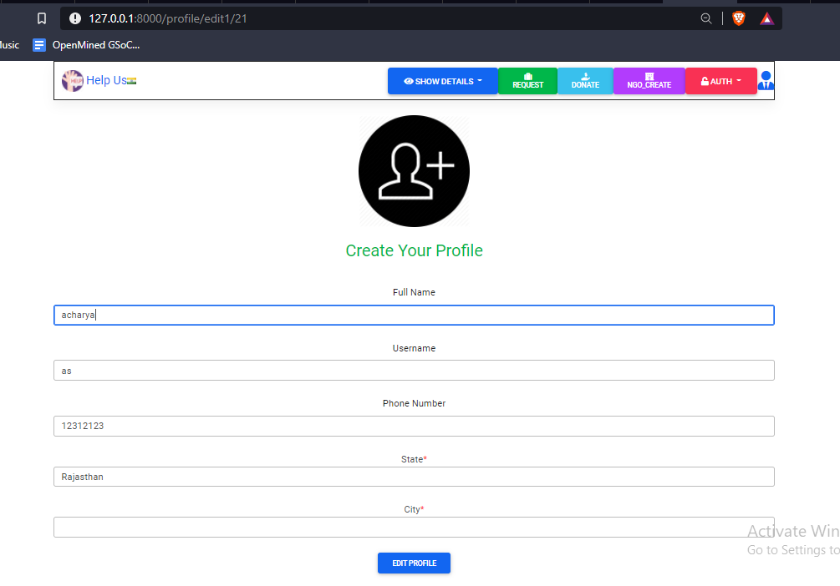
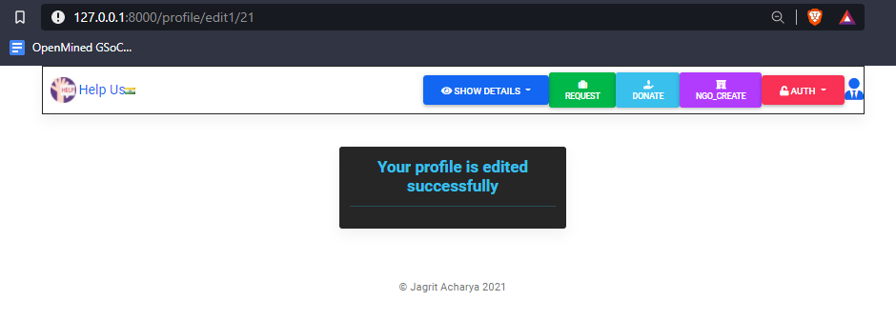
you can edit your profile
(“http://127.0.0.1:8000/profile/edit1/17”)

Slide 35
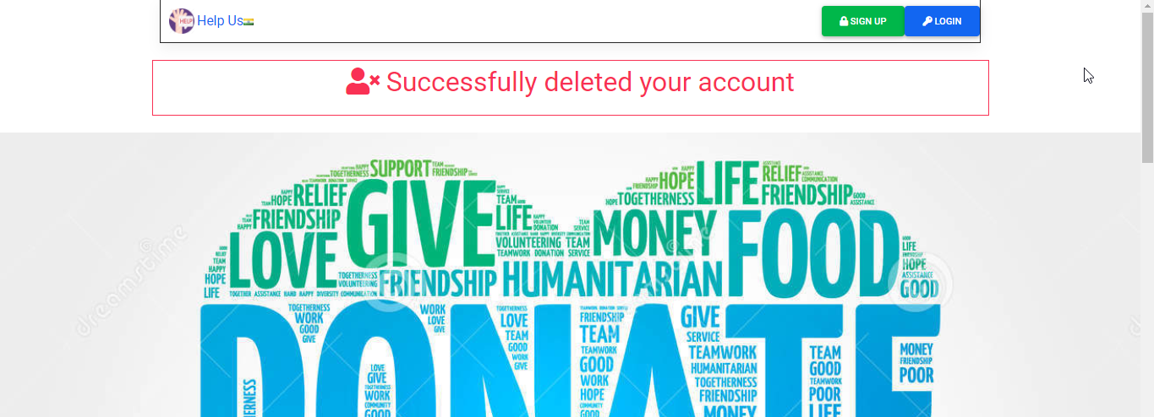
you can also Delete your profile

Slide 36
As discussed in the problem statement we believe we have very much solved the problem, by creating a website where user can DONATE as well as request FOR HIS/HER NEED & where NGO can also request tHIEr needs. hence if we scale UP this website, we can create an ecosystem that will be beneficial & efficient for everyone .
CONCLUSION

